Slide 1
Evaluating SciStream (Federated Scientific Data Streaming Architecture) on FABRIC
Chengyi Qu (University of Missouri - Columbia),
Joaquin Chung (The University of Chicago),
Zhengchun Liu, Tekin Bicer, Rajkumar Kettimuthu (Argonne National Lab)
Notes:
‹#›

Slide 2
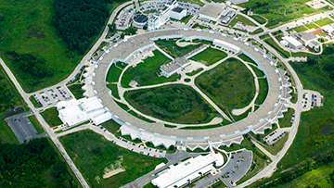
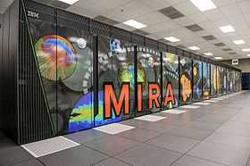
Stream Processing in Light Source Facilities
A Science Driver
Experiment
Data Analysis
Transfer data
Visualize and Steer
Notes:
Motive by providing a science driver (light sources)
Talk about the APS, data analysis and experimental steering

Slide 3
Data Movement Workflow
State of the Art
Notes:
How data movement happens today.
Talk about Science DMZ
Staging data in file systems at DTNs → Why this isn’t sufficient for streaming analysis?

Slide 4
Secure, Memory-to-Memory Data Streaming
The Need
We want SciStream!!!
Notes:
Describe secure, memory-to-memory data streaming

Slide 5
Contributions of SciStream
A middlebox-based architecture to enable (third-party initiated) data streaming between nodes (with no direct external network connection) in multiple security domains in scientific environments
A suite of protocols to establish authenticated and transparent connection between producer and consumer (in different security domains) via intermediate gateway nodes (i.e., middleboxes or proxies)
A prototype and evaluation results showing that a streaming application running over a SciStream environment has a throughput one order of magnitude larger than a streaming application running on a state-of-the-art scientific environment

Slide 6
Agenda
Motivation
Contributions
Design Consideration
SciStream Design
Architecture and software components
Control Protocol
Prototype Implementation
Evaluation
Future Work

Slide 7
Design Considerations
Third-party Streaming: streaming requests are initiated by a “third-party” user or application from anywhere
Secure Streaming: SciStream should authenticate all control and data channels by default
General and Transparent Streaming: we want to make SciStream agnostic of streaming application and avoid instrument/HPC resources reconfiguration
Provisioned vs. Best-effort resources: advanced reservation is supported in many HPC resources and research and education networks, but we want SciStream to also support on-demand requests with best-effort resources

Slide 8
SciStream Design
Architecture

Slide 9
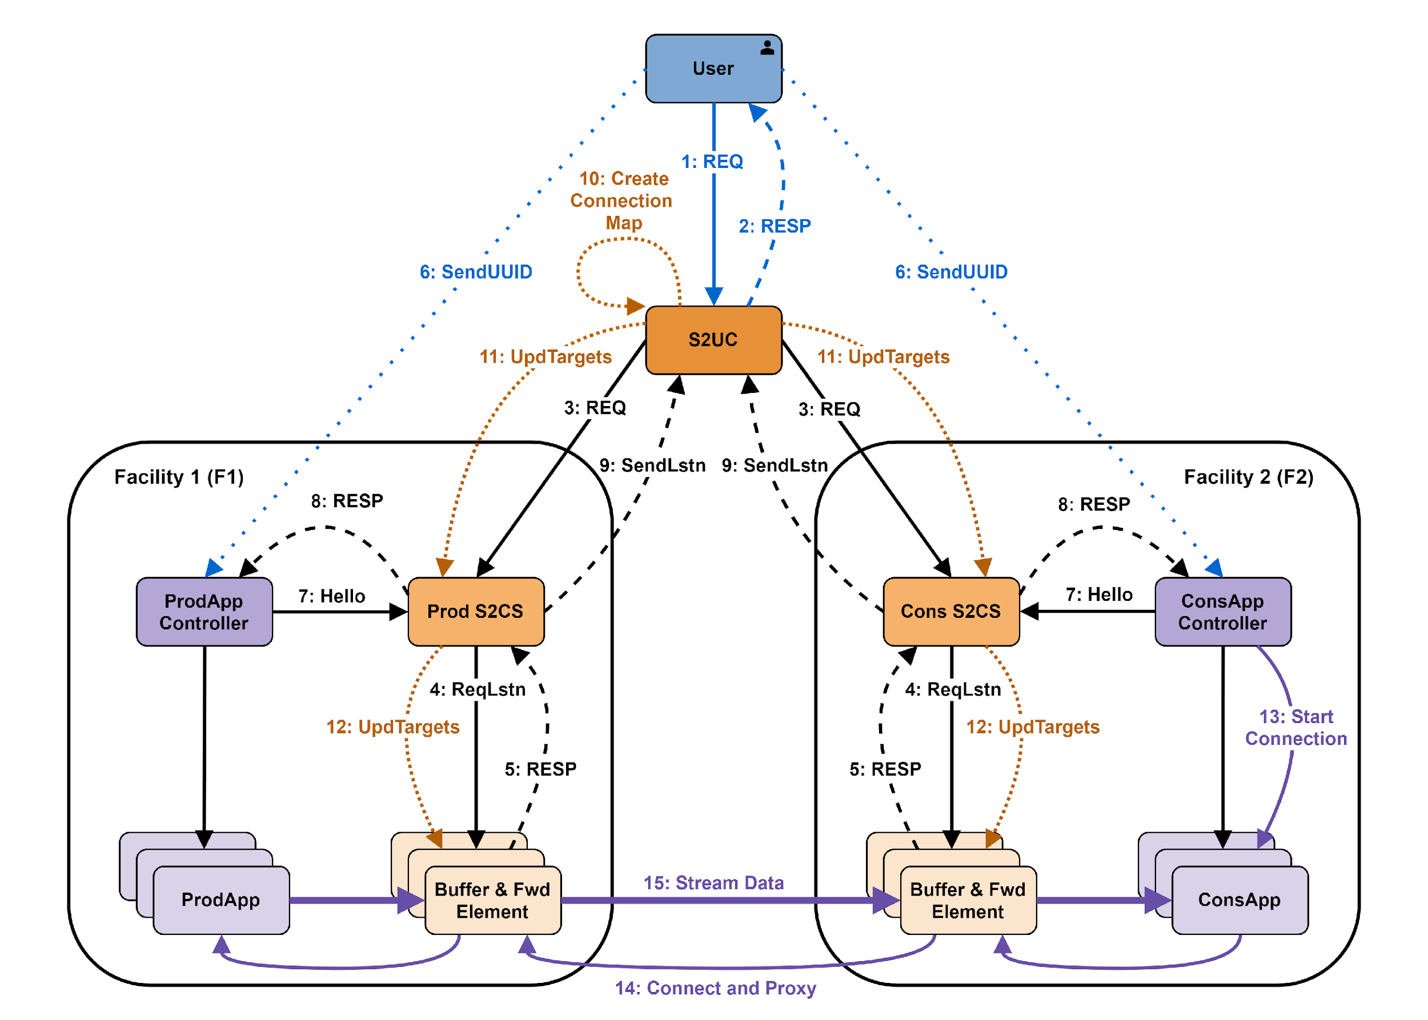
SciStream Design
Control Protocol
S2UC – SciStream User Client
S2CS – SciStream Control Server
S2DS – SciStream Data Server
S2DS
S2DS

Slide 10
Implementation
SciStream Control Server (S2CS) and Data Server (S2DS)
S2CS:
Implemented in Python using state machine,
Memory footprint is 10MB,
Data streaming request is completed in ~0.12 s while a release is completed in 0.003 s
S2DS (Implementation options):
L3 NAT or tunnels
L4 Proxy (TCP or UDP or QUIC)
L7 (Application) Proxy

Slide 11
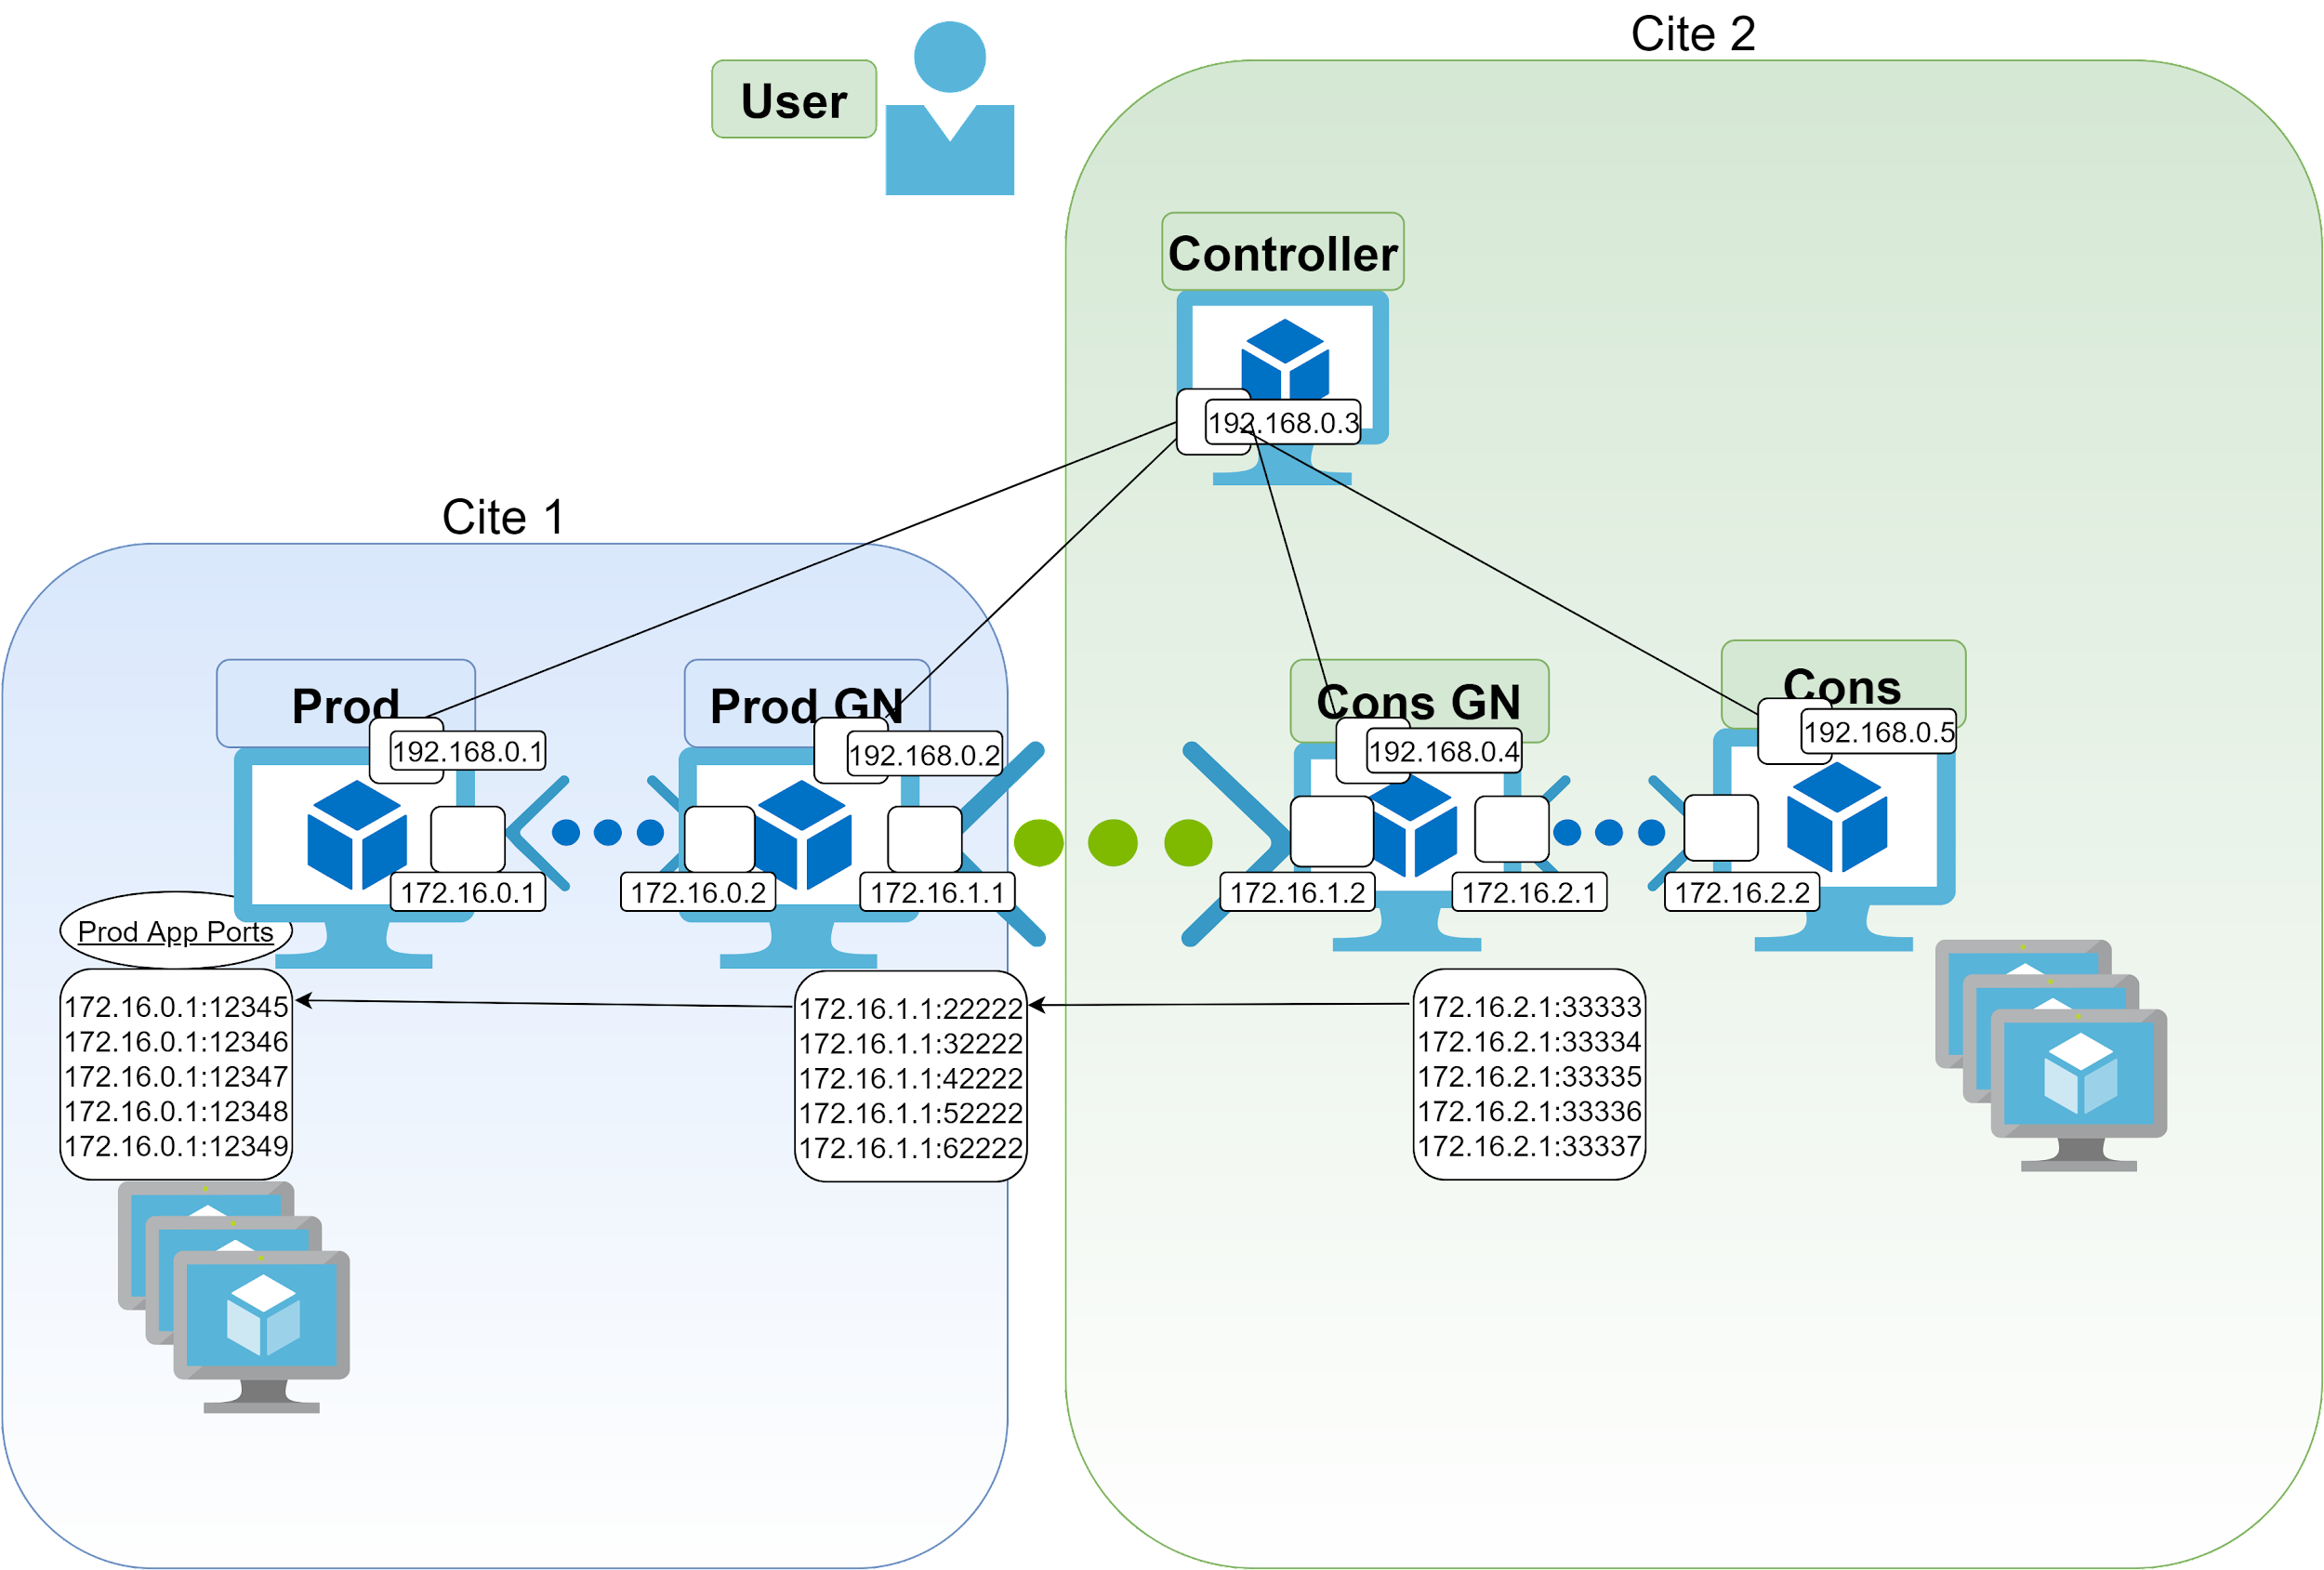
Fabric Topology for current SciStream project
Demo Video: https://youtu.be/ca2k_vpibYk
Notes:
https://drive.google.com/file/d/124xh4K15c7tUcaETXmj-JSPKcQLA_oTC/view?usp=sharing

Slide 12
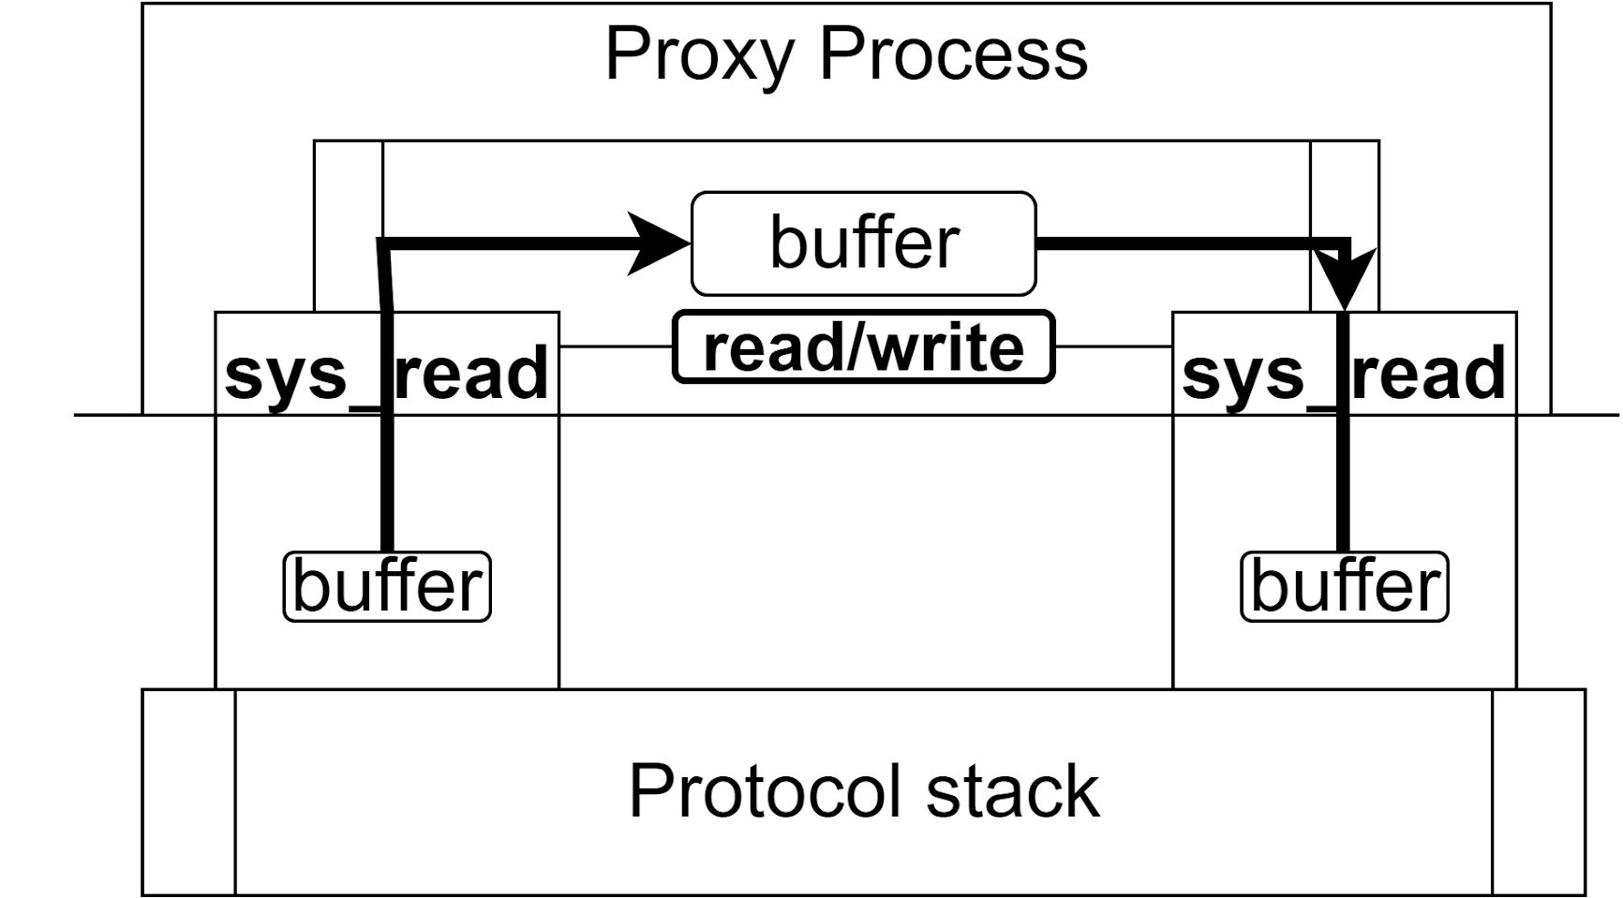
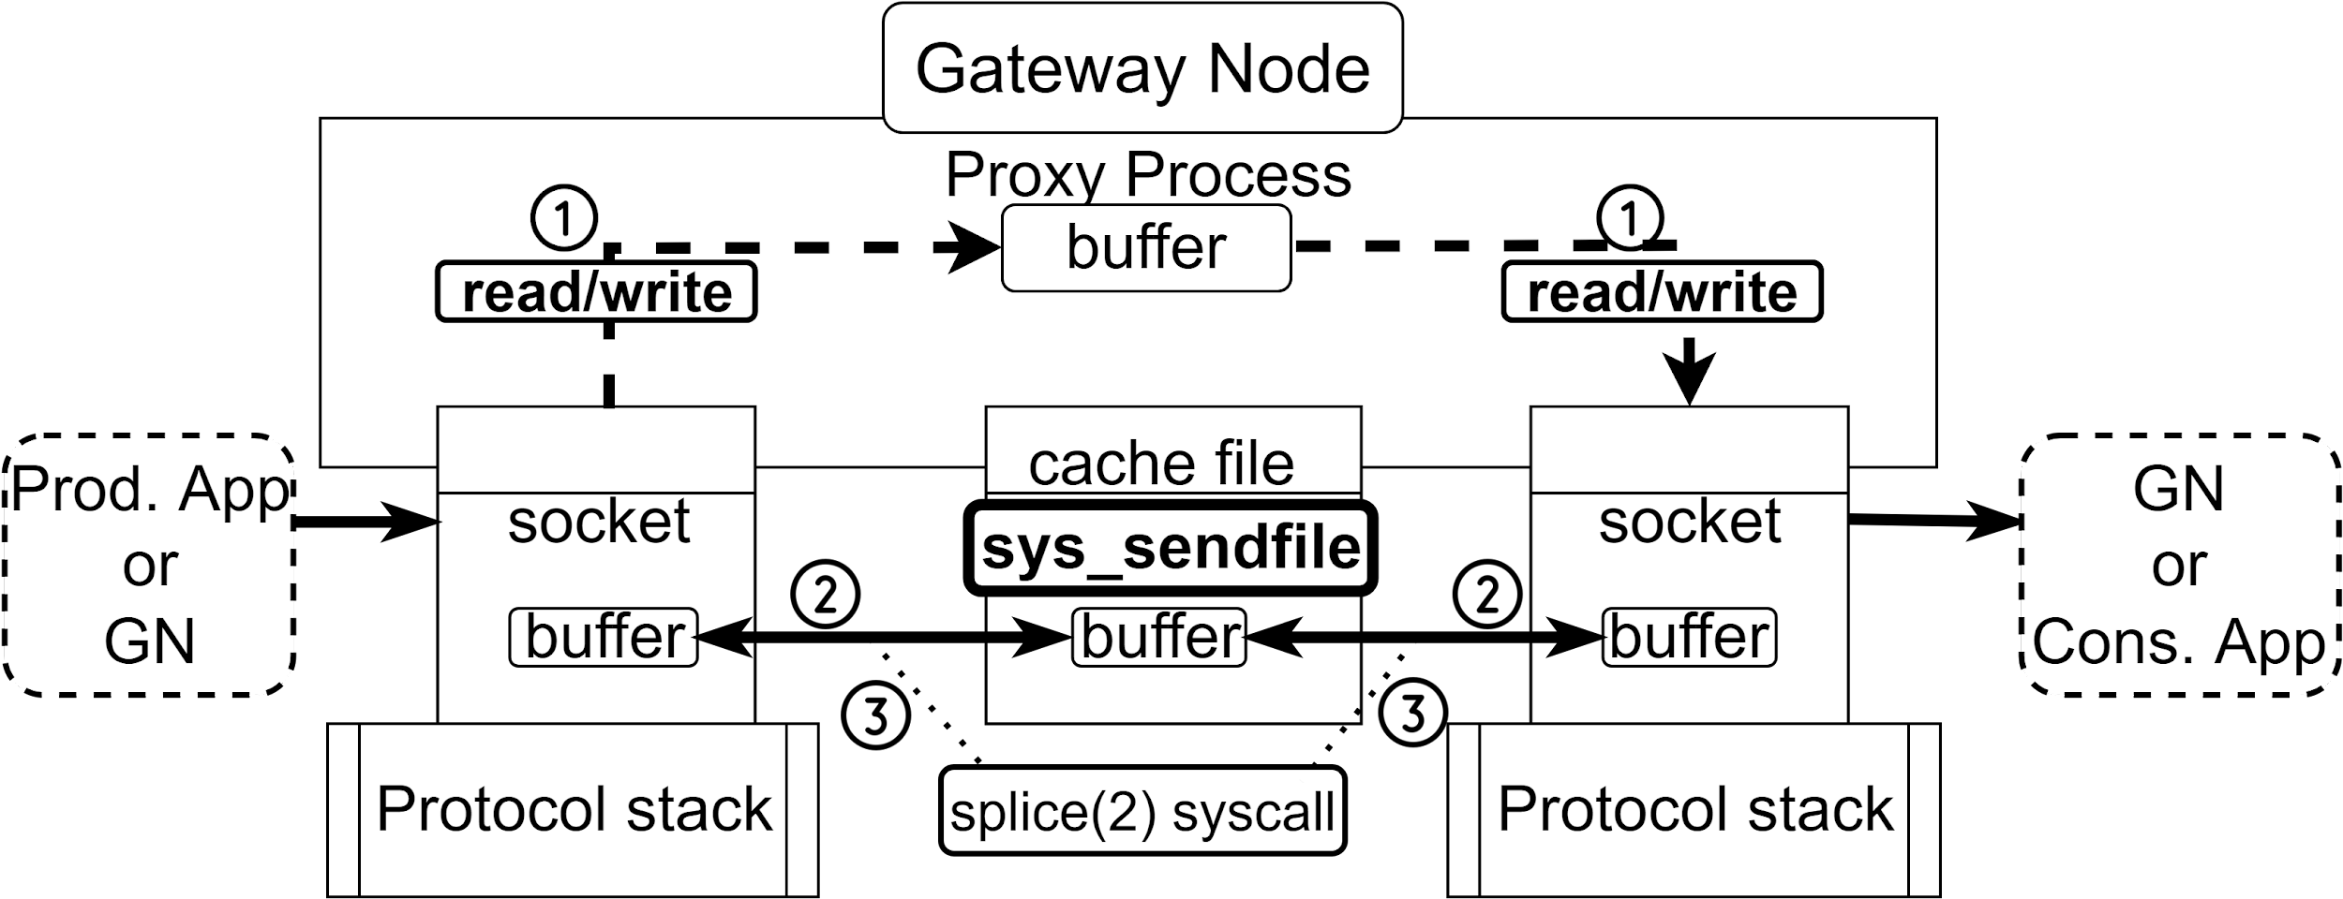
Potential solutions for TCP L4 proxy for current SciStream

Slide 13
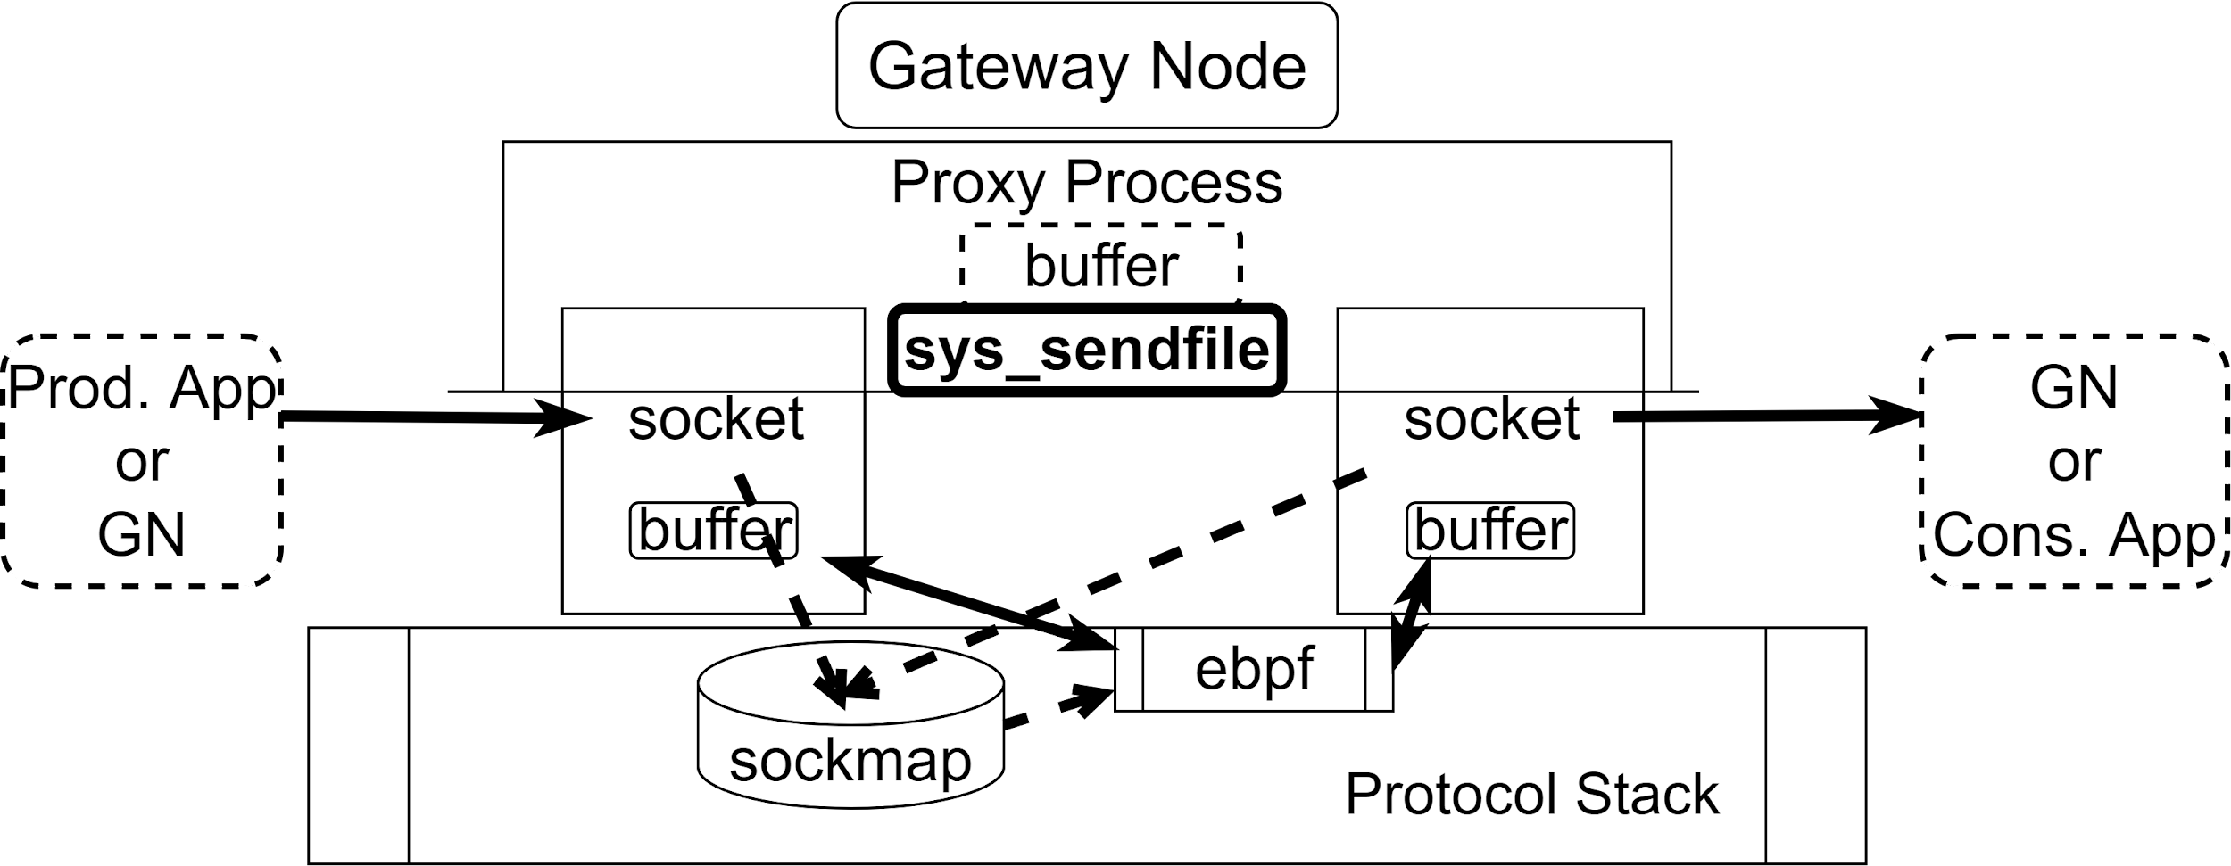
Sockmap with eBPF on TCP Proxy - Overview
+ Sockmap will take over all the forwarding logic by replacing the original sk_data_ready callback function. The original sk_data_ready function, used in socket programming, is an interface between the protocol stack with proxy process, it wakes up user-space every time a packet arrives.
+ Sockmap uses a ‘Stream Parser’ method to change the control logic of packets to eBPF system. This shortens the process and achieves the redirection on kernel space only.
- Sockmap cannot change buffer size, if a large amount of data arrives, it may drop a lot of packets.
- Sockmap only supports TCP traffic, which is written by default in the kennel of Linux systems.

Slide 14
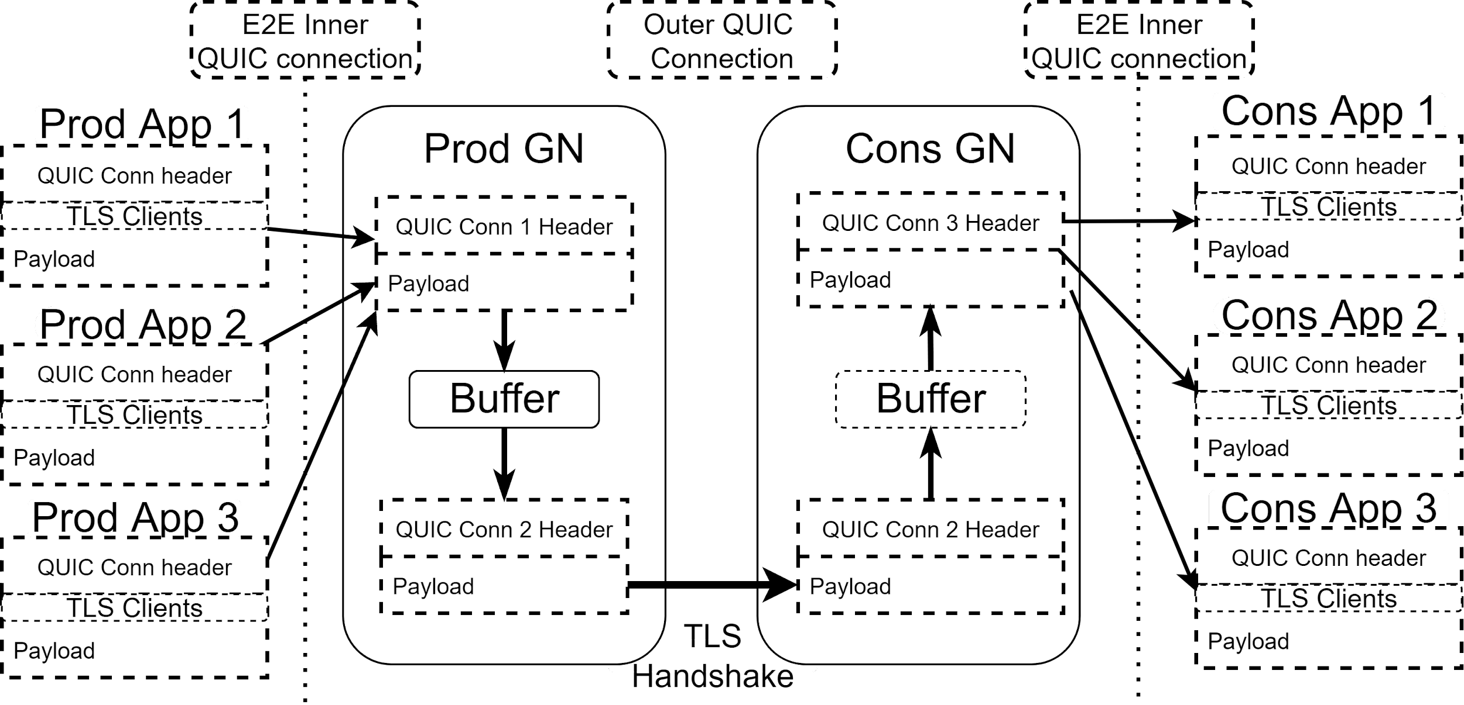
A pure QUIC proxy implementation - Using QUIC-GO

Slide 15
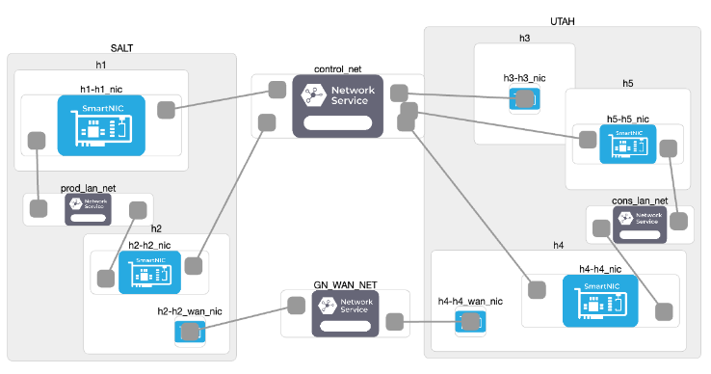
Evaluation
S2DS Implementation Options
Experimental setup on FABRIC - one example on LAN (Salt to Utah)
Compared among 5 topologies with RTT of:
Measurements:
Goodput evaluation
Perceived delay
Jitter
*LAN (SALT to UTAH), Metro (MICH to STAR), Short WAN (STAR to DALL), WAN (UTAH to MAX), Long WAN(MICH to TACC)
Notes:
In this presentation I won’t show the IB results.
We define goodput as the size of the received dataset divided by the elapsed time between the arrival of the first sample and the arrival of a STOP message

Slide 16
Evaluation
S2DS Goodput - Direct connection, Legacy SciStream and Sockmap
Goodput performance of two TCP implementations of SciStream S2DS (legacy and sockmap proxies) compared with the No-SciStream case over five network setups: (a) LAN, (b) metro, (c) short WAN, (d) WAN, and (e) long WAN.
Notes:
For this experiment, the producer generates samples as fast as possible (i.e., no sampling delay). In each experiment we transfer 10 GB for a fixed sample size, which we vary across experiments from 512 bytes to 1 MB in power-of-two increments.

Slide 17
Evaluation
Perceived delay at the consumer application
Perceived delay at the consumer application for two TCP implementations of SciStream S2DS (legacy and sockmap proxies) compared with the No-SciStream case over five network setups: (a) LAN, (b) metro, (c) short WAN, (d) WAN, and (e) long WAN.

Slide 18
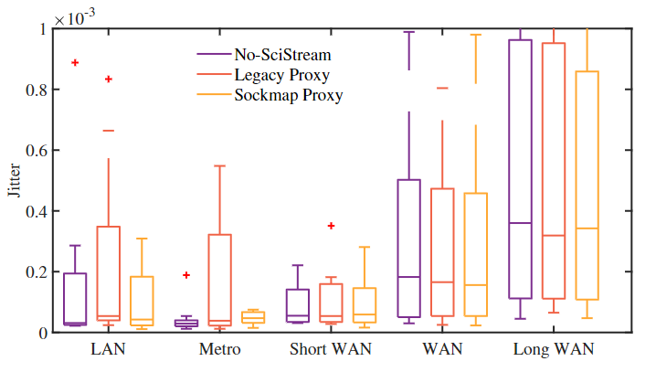
Evaluation
Jitter comparison - box plot
Jitter performance of two TCP implementations of SciStream S2DS (legacy and sockmap proxies) compared to the No-SciStream case.

Slide 19
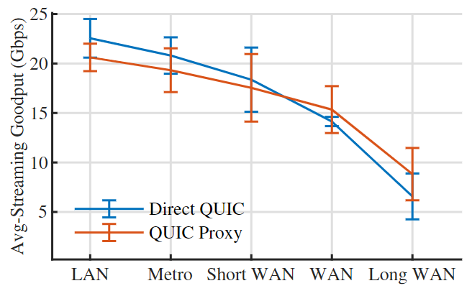
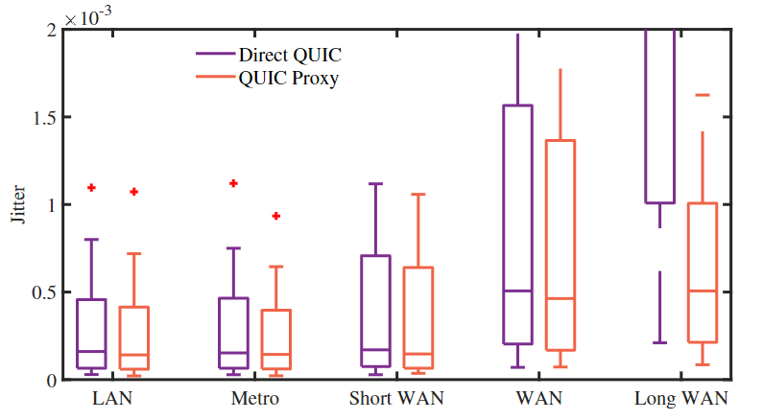
Evaluation
SciStream over QUIC

Slide 20
Thanks!
Questions:
cqy78@mail.missouri.edu
chungmiranda@anl.gov
Acknowledgments
Notes:
‹#›

