Slide 1
EJ-FAT
Stacey Sheldon
Yatish Kumar, Michael Goodrich, Graham Heyes
Notes:
‹#›

Slide 2
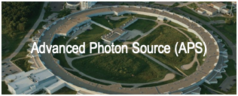
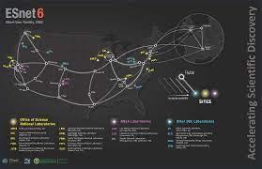
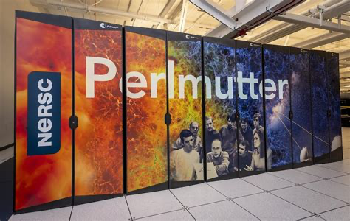
End to End science problem and motivation
DAQ
Compute Node
DAQ
Compute Node
DAQ
Compute Node
Compute Node
ESNET
Compute Node
DAQ
Compute Node
Compute Node
Compute Node
DOE needs to stream N x 400G A/D samples from very large instruments to its HPC / Supercomputers for processing
Extreme Scale Streaming ( 400G / 800G / 1.2T … )
Very long latencies across North America ( 30 ms / 60 ms … )
No time for retransmission. Data loss is treated as “noise” and compute keeps going
SC22 | Dallas, TX | hpc accelerates.
*
‹#›

Slide 3
End to End science problem and motivation
DAQ
Compute Node
DAQ
Compute Node
DAQ
Compute Node
Compute Node
ESNET
Compute Node
DAQ
Compute Node
Compute Node
Compute Node
DOE has dozens of large instruments spread out across the country
Each instrument will produce Nx400G streams of DAQ data based on emerging sensors
This requires real time processing in order to:
Preview and tune the experiment to ensure well focused beams, x-rays and samples
Use compute to identify events, particles, image frames etc.
Select what to store
Discard the raw DAQs for up to 1000000:1 data reduction
SC22 | Dallas, TX | hpc accelerates.
*
‹#›

Slide 4
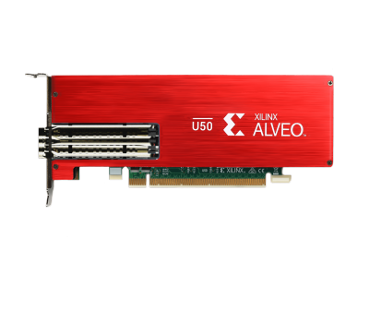
Design Goals
Event Q Feedback
DAQ
Unidirectional UDP Stream
EJ-FAT
FPGA + Switch
Compute Node
DAQ
DAQ
ESNET
DAQ
Compute Node
AS: 345 203.58.0.0/16
AS: 999 102.12.2.0/8
1) Separation of IP Addresses
2) In network sorting of Event Data
3) Stateless load balancing
4) Compute node feedback for dynamic LB
5) Hit-less reconfiguration of LB table
6) Unidirectional UDP streaming

Slide 5
Implementation - Data Plane Packet Rewrite
Data
LB
UDP
LB IP
Eth
Eth | LB Dst MAC | Next HOP Router / CN MAC
IP | LB Dst IP | CN Dst IP
UDP | LB well known port | CN UDP Dst port
LB | Event ID | — Header Popped
** Fine Print : Src IP rewritten to LB IP, ARP/ND used to resolve next-hop Dst MAC, UDP Dst port used to select a CPU within the CN, LB responds to upstream ARP/ND/ping, packets dropped if wrong Eth, IP addr/port or LB header.
Data
UDP
CN IP
Eth

Slide 6
Implementation - Data Plane Selecting a CN
Compute Node Details
0 | CN #A
1 | CN #B
… | CN #B
511 | CN #Z
CN A | ETH | IP | UDP
CN B | ETH | IP | UDP
CN Y | ETH | IP | UDP
etc..
63
9
8
0
Event ID
Event ID
Select
Calendar
Slot
0 | CN #Y
1 | CN #Y
… | …
511 | CN #Z
Multiple active epoch tables ensures make before break forwarding
Atomic transition between epochs on event # boundaries
Multiple entries for the same CN controls “weight” of that CN
512 entry epoch table balances table size vs. # CN
it is adjustable by recompiling the FPGA
Indirection for CN Details, helps compress memory and speeds up table programming
Select Epoch
> 53,000 | last epoch
> 209,000 | this epoch
TBD | next epoch
unused | —-
0 | CN #Y
1 | CN #O
… | …
511 | CN #W

Slide 7
Implementation - Control Plane Updating the LB
Time
Start with a default LB
Monitor CN Q Fill
Build a new epoch table
Activate New Epoch
Wait
Release Old Epoch
Monitor CN Q Fill
0 | CN 0
1 | CN 1
2 | CN 2
N | CN 1
CN 0 | oooo______
CN 1 | oooooooo__
CN 2 | o_________
0 | CN 0
1 | CN 1
2 | CN 2
N | CN 1
0 | CN 0
1 | CN 1
2 | CN 2
N | CN 1
0 | CN 0
1 | CN 1
2 | CN 2
N | CN 2
CN 0 | oooo______
CN 1 | ooooo_____
CN 2 | oooo______
0 | CN 0
1 | CN 1
2 | CN 2
N | CN 2
0 | CN 0
1 | CN 1
2 | CN 2
N | CN 2

Slide 8
Test Setup
DAQ Source Emulator
Real Load Balancer HW
Compute Node
DAQ Packet Sequence Generator SW
FPGA Server
Compute Node Server
U280 FPGA
DAQ.pcapng
DPDK pcap Replay
- multi DAQ
- network jitter
- random order DAQ
- event overlap
tcpdump
- HW TS (ns)
- 100Gbps Rx
CN.pcapng
Ethernet @ 100Gpbs
PCIe @ 100Gpbs Packet Inject + P4 Table Config
This is the physical setup for the test results in this paper: - It is a packet level test centered on the LB
Streaming has been done in a larger system, with full science streaming and reconstruction

Slide 9
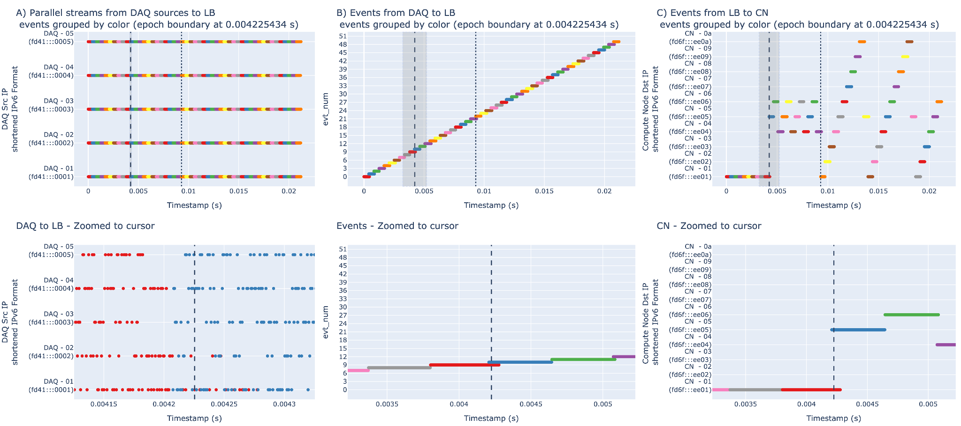
Test Results

Slide 10
Thank You
Contact : smartnic@es.net
Implemented using : https://github.com/esnet/esnet-smartnic-hw

