Slide 1
App2Net: Moving Application Functions to Network & a Case Study on Low-latency Feedback
Ganesh C Sankaran | USC/ISI
Joaquin Chung | Argonne National Laboratory
Raj Kettimuthu | Argonne National Laboratory

Slide 2
Motivation
Stage 1
Stage 2
Stage 3
Today, Network resources are not involved in application design
Why involve network?
Low latency
High throughput
Custom processing (Programmable networks)
When to involve network?
Packet
Eth
IP
Data
Eth
IP
Data
Eth
IP
Data
Code
ALU
ALU
ALU
Table
 | a
 | b
 | c
Notes:
Hot data processing pipeline: a unique resource profile
Packet the only moving part
Pre-defined fixed pipeline
Every stage
has dedicated resources
Bound by latency

Slide 3
Motivation
Feedback loop
Data source
@ Geo X
Compute resource @ Geo Y
Today, Network resources are not involved in application design
Why involve network?
When to involve network?
Quickly find needle in a haystack type workloads
Payload based low latency feedback
High data rate
Existing
feedback loop
Low-latency
Feedback loop
Data source
@ Geo X
Compute resource @ Geo Y
In-Network
High data rate
Notes:
Hot data processing pipeline: a unique resource profile
Packet the only moving part
Pre-defined fixed pipeline
Every stage
has dedicated resources
Bound by latency

Slide 4
Case study
Light source experiment generates high data rate streams (~10 Gbps)
Typical data flow:
From instrument in one location to HPC in another
HPC computes calibration parameters and notifies the instrument.
Instrument is calibrated based on feedback from HPC
Data = Information + noise
Noise sources: systematic electronic noise, misalignment of images, etc.
Why feedback latency is important?
Instrument generates images with current calibration parameters until informed
Can programmable data plane detect miscalibration and inform the instrument?
Notes:
Any diagram that we can use ?

Slide 5
Motivation
Today, Network resources are not involved in application design
Why/ When to involve network?
How to involve network?
Exclusive programming model/ language/ tool chain/ environment
As a programmer, more challenges than solutions
My comfort zone
SQL
MapReduce
Python …
Exclusive zone
P4
NPL
SDx
??
Notes:
Hot data processing pipeline: a unique resource profile
Packet the only moving part
Pre-defined fixed pipeline
Every stage
has dedicated resources
Bound by latency

Slide 6
Motivation
Today, Network resources are not involved in application design
Why/When/How to involve network
Need a simple yet powerful programming model
Simple in terms of adoption
Powerful in terms of representing domain nuances
My comfort zone
SQL
MapReduce
Python …
Exclusive zone
P4
NPL
SDx
??
Notes:
Hot data processing pipeline: a unique resource profile
Packet the only moving part
Pre-defined fixed pipeline
Every stage
has dedicated resources
Bound by latency

Slide 7
Challenges
Data plane programming languages (P4, etc.) exploit programmable switch hardware features
Deep expertise required in data plane programming languages & algorithm design for programmable switch hardware
Switch hardware features not comparable to existing CPU or GPU
Restrictions imposed on functional blocks such as parsing does not support control statements
Memory access outside packet buffer restricted

Slide 8
Challenges
Data plane programming languages (P4, etc.) exploit programmable switch hardware features
Deep expertise required in data plane programming languages & algorithm design for programmable switch hardware
Programmable data planes operate on network headers and not on the payload
Many scientific application payloads carry structured data (SQL table output, image pixels, etc.)
Payloads that are not well defined or overflow packet boundaries or encrypted not handled

Slide 9
Challenges
Data plane programming languages (P4, etc.) exploit programmable switch hardware features
Deep expertise required in data plane programming languages & algorithm design for programmable switch hardware
Programmable data planes operate on network headers and not on the payload
Many scientific application payloads carry structured data (SQL table output, image pixels, etc.)
CPU based machines handle repetitions quite well but programmable switch hardware cannot handle repetitions
For loops not supported
Conditional branching supported in some functional blocks and not in others

Slide 10
Challenges
Data plane programming languages (P4, etc.) exploit programmable switch hardware features
Deep expertise required in data plane programming languages & algorithm design for programmable switch hardware
Programmable data planes operate on network headers and not on the payload
Many scientific application payloads carry structured data (SQL table output, image pixels, etc.)
CPU based machines handle repetitions quite well but programmable switch hardware cannot handle repetitions
Payload based filtering involves understanding the current data in N-dimensions and comparing it with the region of interest
Float operations are not supported
Many standard Math library functions e.g., sin, cos not supported

Slide 11
Challenges
Data plane programming languages (P4, etc.) exploit programmable switch hardware features
Deep expertise required in data plane programming languages & algorithm design for programmable switch hardware
Programmable data planes operate on network headers and not on the payload
Many scientific application payloads carry structured data (SQL table output, image pixels, etc.)
CPU based machines handle repetitions quite well but programmable switch hardware cannot handle repetitions
Payload based filtering involves understanding the current data in N-dimensions and comparing it with the region of interest
Data plane has limited notification capability when compared to CPU based hardware
Programmable switches still grappling to support changes at runtime

Slide 12
Approach
Source-to-source converter using an intermediate representation
Need a simple yet powerful model for conversion
Simple
Less complex from NxN to 2N
No new language: JSON
No new representation: IR
Frontend
SQL
MapReduce
Python
JSON IR
Compiler
Code Gen
Backend
P4
NPL
SDx
Notes:
Hot data processing pipeline: a unique resource profile
Packet the only moving part
Pre-defined fixed pipeline
Every stage
has dedicated resources
Bound by latency

Slide 13
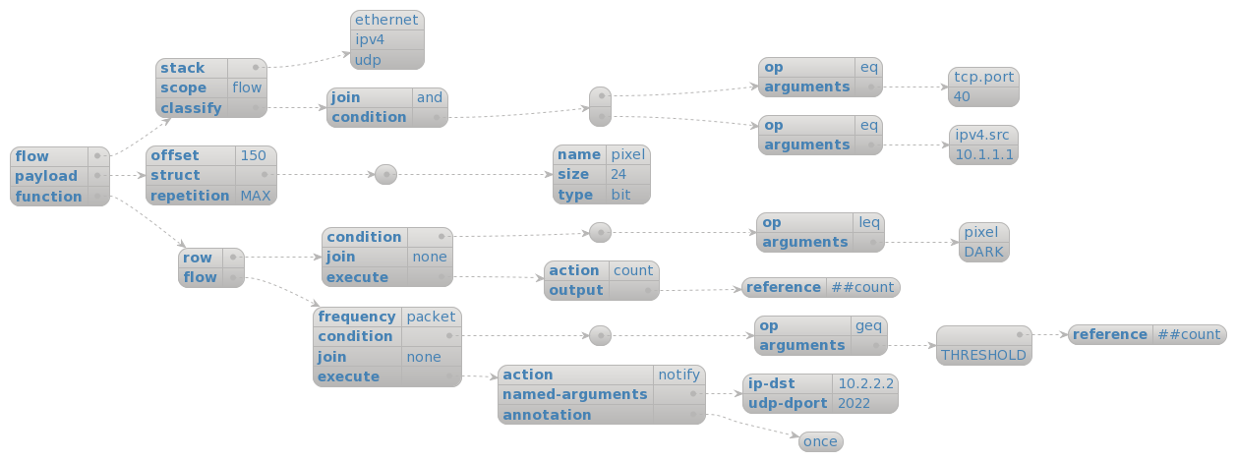
Approach
Source-to-source converter using an intermediate representation
Need a simple yet powerful model for conversion
Powerful
Domain specific IR
Specific to Low latency feedback system
notify X when field Y in flow Z is out of range R
Notes:
Hot data processing pipeline: a unique resource profile
Packet the only moving part
Pre-defined fixed pipeline
Every stage
has dedicated resources
Bound by latency

Slide 14
Approach
Source-to-source converter using an intermediate representation
Need a simple yet powerful model for conversion
Powerful
Domain specific IR
notify X when field Y in flow Z is out of range R
Notes:
Hot data processing pipeline: a unique resource profile
Packet the only moving part
Pre-defined fixed pipeline
Every stage
has dedicated resources
Bound by latency

Slide 15
Approach
Source-to-source converter using an intermediate representation
Need a simple yet powerful model for conversion
Powerful
Domain specific IR
notify X when field Y in flow Z is out of range R
Notes:
Hot data processing pipeline: a unique resource profile
Packet the only moving part
Pre-defined fixed pipeline
Every stage
has dedicated resources
Bound by latency

Slide 16
Approach
Source-to-source converter using an intermediate representation
Need a simple yet powerful model for conversion
Powerful
Domain specific IR
notify X when field Y in flow Z is out of range R
Notes:
Hot data processing pipeline: a unique resource profile
Packet the only moving part
Pre-defined fixed pipeline
Every stage
has dedicated resources
Bound by latency

Slide 17
Approach
Source to source converter using an intermediate representation
Need a simple yet powerful model for conversion
Powerful
Domain specific IR
notify X when field Y in flow Z is out of range R
Notes:
Hot data processing pipeline: a unique resource profile
Packet the only moving part
Pre-defined fixed pipeline
Every stage
has dedicated resources
Bound by latency

Slide 18
Results from prototype compiler
Flow
control logic (inout headers hdr) {
apply {
if (hdr.ethernet_t.isValid() && hdr.ipv4_t.isValid() &&
hdr.udp_t.isValid() &&
(hdr.tcp.port == 40 &&
hdr.ipv4.src == "10.1.1.1")) {
Notes:
Hot data processing pipeline: a unique resource profile
Packet the only moving part
Pre-defined fixed pipeline
Every stage
has dedicated resources
Bound by latency

Slide 19
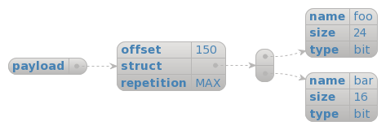
Results from prototype compiler
Flow
Payload
header offset_t {
bit<150> skip;
}
header payload_t {
bit<24> pixel;
}
struct headers {
ethernet_t ethernet;
ipv4_t ipv4;
offset_t offset;
payload_t pload0;
payload_t pload1;
…
}
parser Pixelparser (packet_in packet, out headers hdr) {
state start {
packet.extract(hdr.offset);
packet.extract(hdr.pload0);
packet.extract(hdr.pload1);
…
transition accept;
}
Notes:
Hot data processing pipeline: a unique resource profile
Packet the only moving part
Pre-defined fixed pipeline
Every stage
has dedicated resources
Bound by latency

Slide 20
Results from prototype compiler
Flow
Payload
Function
if (count >= THRESHOLD) {
meta.ipv4dst="10.2.2.2";
meta.udpdport=2022;
notify();
}
if ((hdr.pload0.pixel <= DARK)) { count=count+1; }
if ((hdr.pload1.pixel <= DARK)) { count=count+1; }
Notes:
Hot data processing pipeline: a unique resource profile
Packet the only moving part
Pre-defined fixed pipeline
Every stage
has dedicated resources
Bound by latency

Slide 21
Future directions
Associating a variable’s lifetime (e.g., flow, packet, etc.)
Intermediate representation can have multiple conditions but supports only one action currently
No wildcard support
For more details check out : https://github.com/gsankara/json2p4-compiler-prototype/
We invite the community to contribute

