Slide 1
Contributor Relations Webinar
April 21 and 23, 2026
SCinet Contributor Relations Team and
SCinet Logistics Team

Slide 2
Today’s Agenda
SC26/SCinet 26
2026 Leadership Team
About Contributor Relations and Logistics
Benefits of Being a Contributor
Requirements/Recognition Tiers
Additional Contributor Opportunities
Key Deliverables
Shipping Processes
Key Dates
Resources
Q&A

Slide 3
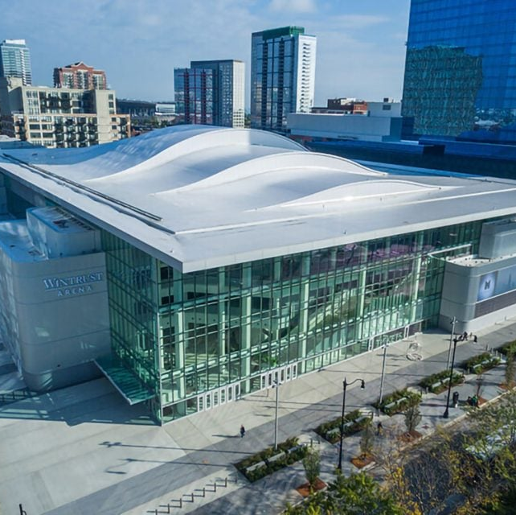
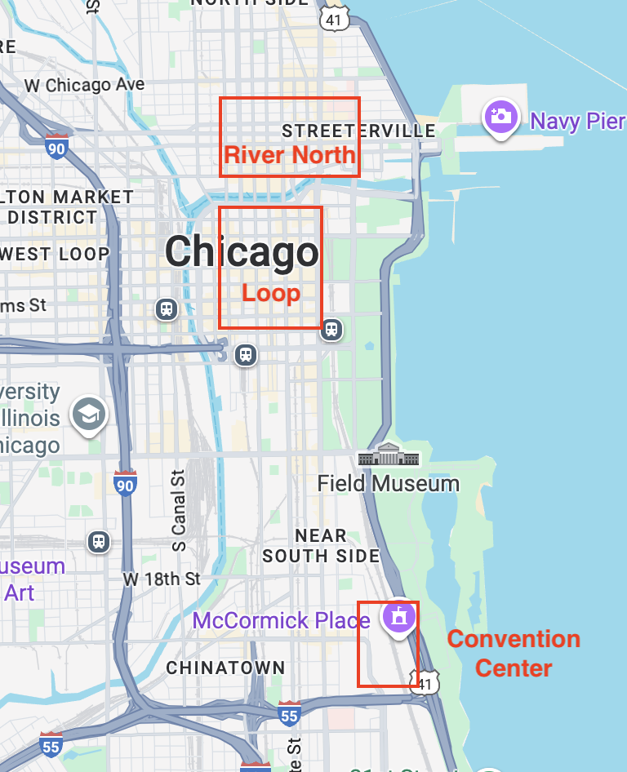
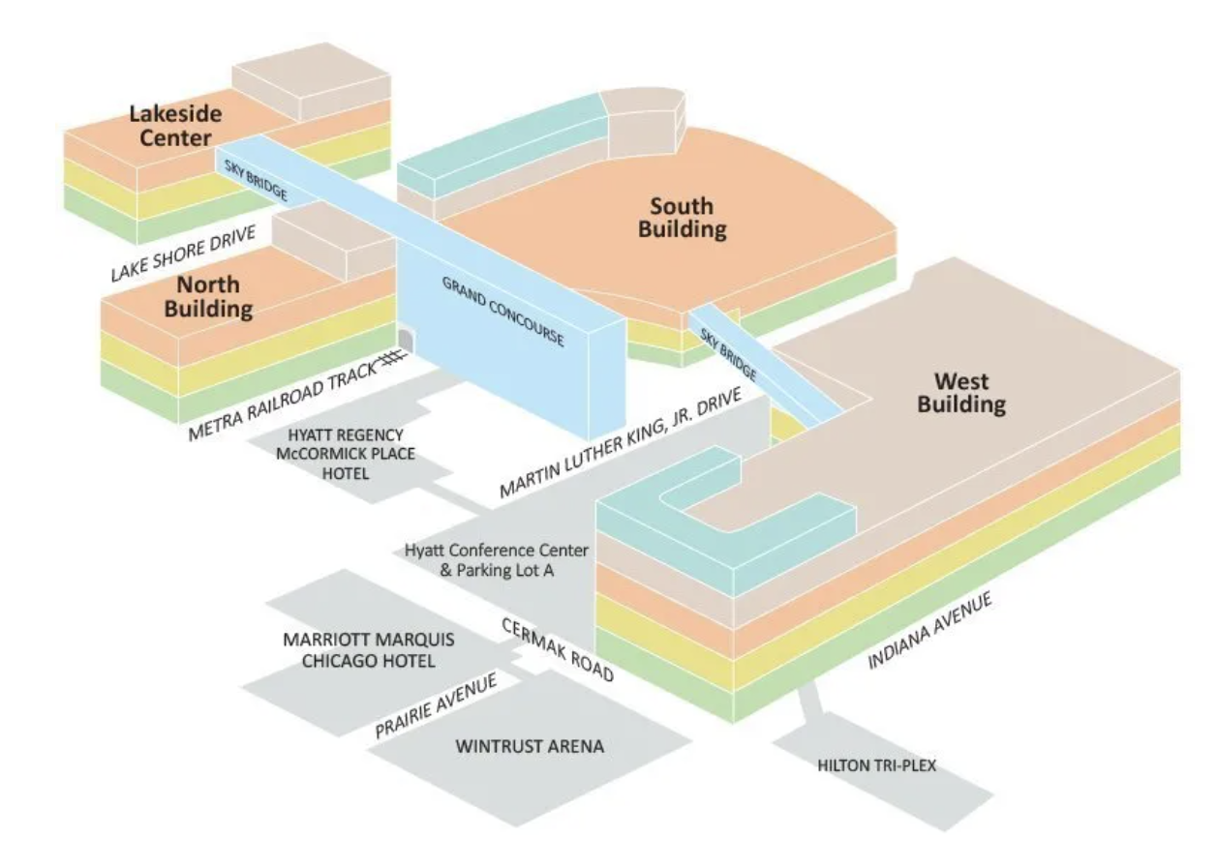
Supercomputing 2026/SCinet 2026
Chicago, IL at McCormick Place
  New Venue for Supercomputing!
  West Building, Halls F1 and F2
  November 16-19

Slide 4
SC26/SCinet 2026 Leadership
Conference General Chair
  Kevin Hayden (Argonne National Lab)
  Former SCinet Chair for SC20
SCinet 2026 Chair
  Dylan Jacob (ESnet)
SCinet 2027 Chair
  Debbie Fligor (University of Illinois Urbana Champaign)
~20 SCinet teams
  About 200 total SCinet participants

Slide 5
Contributor Relations/Logistics Team Members
Contributor Relations Co-Leads
  Brian Smith (ORNL)
  Katrina Trujillo (LLNL)
  Deputy: Matthew Chung (UC Riverside)
  Email: contributor-relations@scinet.supercomputing.org
Logistics Co-Leads
  Patrick Finnegan (Purdue)
  Andy Sydelko (Purdue)
  Email: logistics@scinet.supercomputing.org
CR Portal:
  https://scinet.supercomputing.org/contributor-relations

Slide 6
Why Contribute to SCinet?
SCinet is the world’s fastest and most powerful temporary network
  “1 year to plan, 1 month to build, 1 week to run, 1 day to teardown”
Access and exposure to the largest HPC/AI audience
  19,000+ attendees in 2025
  Exhibit floor already full for 2026
Demonstrate new equipment
  Stress test new equipment in a less stressful environment
Enhance your image by sharing innovative implementations through our communications channels
Connect with decision makers from academia, government, and industry
Elevate your brand awareness through logo placement and speaking opportunities
Participate in the Research Expo and Network Research Exhibition

Slide 7
SCinet Value to Contributors
Participating in SCinet provides credibility and prestige
  SCinet is globally recognized as a leader in high-performance computing networking
  SCinet pushes the boundaries of innovation in networking
    First demonstrations of new technology and network services
  Contributing to SCinet provides competitive differentiation
    Limited set of accepted contributors in crowded markets
  Heterogeneous Environment
    Experiment and validate gear in a unique high-performance multi-vendor environment that is not replicated anywhere else
  Third-party Validation
    SCinet’s endorsement demonstrates that a respected, external authority believes in an organization’s value and technical accomplishments/abilities

Slide 8
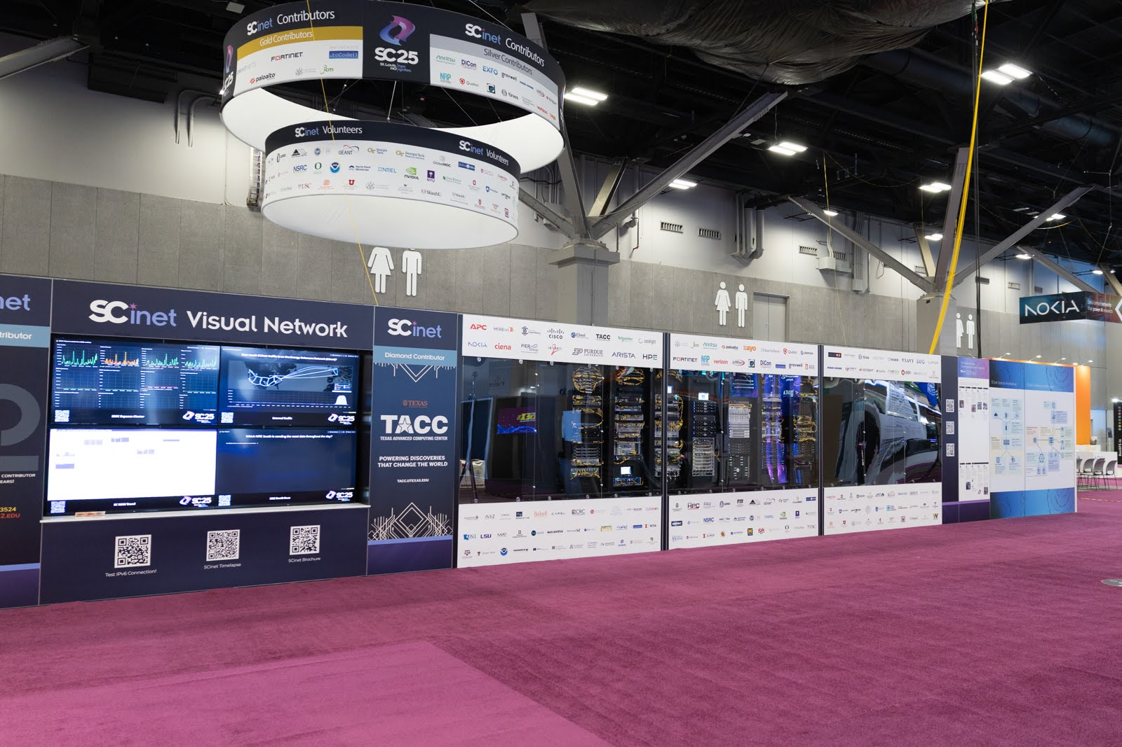
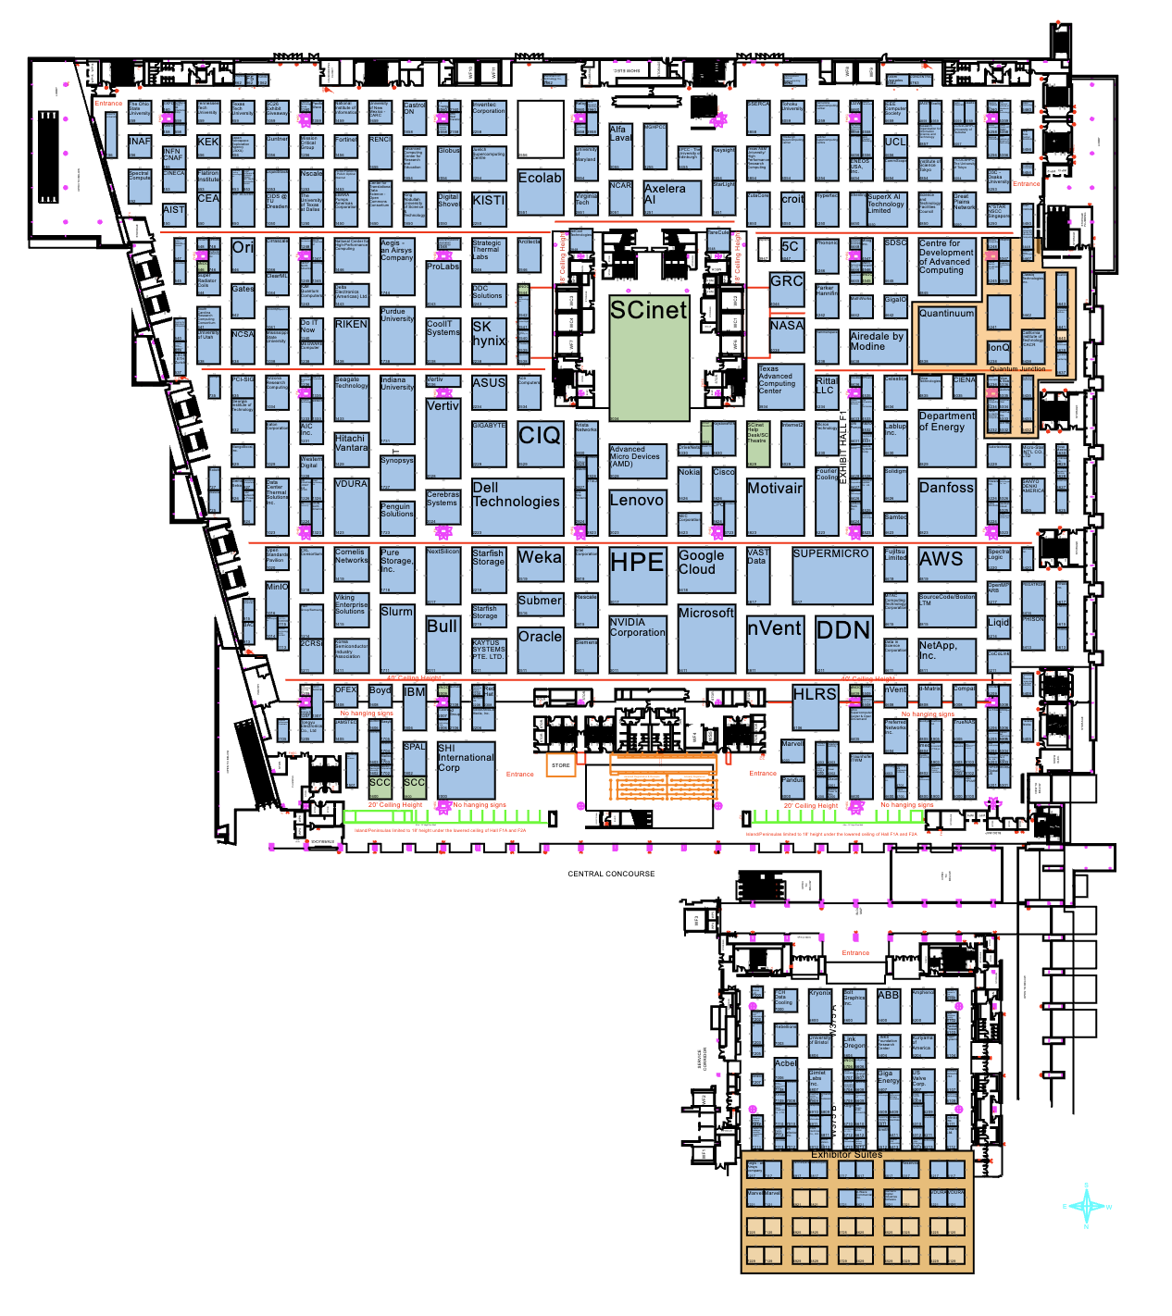
Marketing Benefits of Being a Contributor
SCinet NOC/DNOC wall posters
Logo placement on SCinet banner
SCinet Partner Highlights
SCinet Contributor Webpage
Discounted (or Free) exhibit floor network connections
Press release coordination
Recognition via SCinet Displays
Exhibit Floor Admission(s)
Exhibitor Forum Speaking Opportunities
NOC

Slide 9
Diamond/Platinum Benefits
Logo and mention by SC26 General Chair during Keynote (Diamond only)
Premium/Prominent Logo Placement on NOC and banner
Additional free/discounted wired booth network connection
Recognition in SCinet Awards Ceremony before Opening Gala
See Contributor Guide for full list

Slide 10
SC Theater and Network Research Exhibition (NRE)
SC Theater is a booth on the show floor near the SCinet NOC intended to provide a platform for short presentations relevant to SCinet and SC.
  Contributors welcome to propose sessions for inclusion in the schedule.
    Content must be focused on technologies as opposed to product specific sales pitch
    Can tie into products utilizing the technology and how it provides a SCinet solution.
    contributor-relations@scinet.supercomputing.org
Network Research Exhibition (NRE)
  Live experiments and demos that are run on the show floor utilizing SCinet’s high performance research network for both internal and external connectivity.
  Requires a host booth on the show floor for the demonstration
  https://sc26.supercomputing.org/scinet/network-research-exhibition/

Slide 11
Experimental Networks Team
The Experimental Networks Team engages partners in research, education, and industry to facilitate high-performance networking experiments during the SC Conference within SCinet.
  Pre-production 10GE, OpenFlow, IPv6-only, etc. in past years
For SC26, XNet will build a White Rabbit Precision Time Infrastructure
  Invented at CERN, used by many Chicagoland FinTech firms & Fermilab
  Recent use-cases such as Quantum research have sparked more interest
If you are contributing gear that supports PTP, 1PPS or 10MHZ timesource, consider syncing up with us!
  xnet@supercomputing.org
  Includes gear with capture cards (i.e. IDS) and certain SmartNICs
April 2026
SCinet26 Contributor Relations Webinar

Slide 12
Other Marketing Opportunities
General media inquiries for SCinet - contact the Contributor Relations team first
Contributor Relations will also work with SCinet Contributors to identify areas of interest for future stories
  Content should highlight:
    Contributor technology provided to SCinet
    SCinet volunteers making use of the technology
    Challenges being addressed and impact for the HPC community
SC Communications committee maintains:
  Blog and Newsletter - https://sc26.supercomputing.org/media/blog/
    1st Friday of the Month
  Social Media
    Instagram, YouTube, Facebook LinkedIn, Twitter
  Ongoing Content Series
    Highlight the people and diverse backgrounds in the HPC community

Slide 13
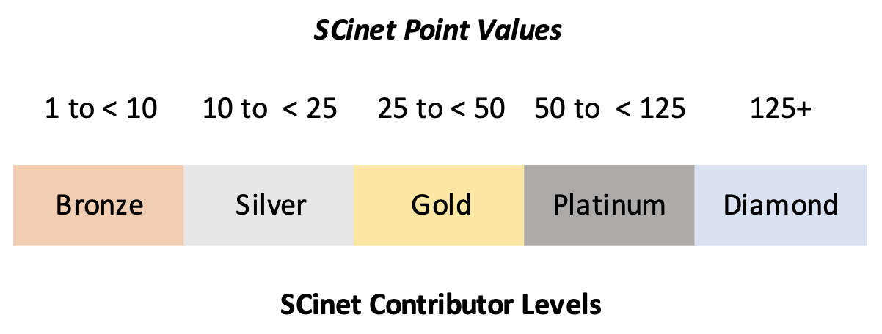
Recognition Tier Changes from 2025
Recognition tier system was revamped in 2024
  Ensure contributor time recognized as well as material loans
  Points awarded for hardware, software/services, and volunteers
  Donated equipment gets a multiplier and then “depreciates” over 5 years
  No changes in 2025
Minor tweaks for 2026
  Exhibit floor passes based on points, but we have increased the default number based on feedback (i.e. min of 3, 4, and 5 for Bronze, Silver, and Gold)
  See the CR Guide for specifics.

Slide 14
Points Process (HW, SW, Bandwidth)
Points are issued based on dollar value of loaned equipment, software, and services (i.e. bandwidth)
  Insured value of hardware (not MSRP) will be used for loaned hardware
    If only MSRP is submitted, SCinet will use 30% of the value for evaluation purposes
  The cost of software licensing (prorated to the months of use, defaulting to 1 unless otherwise explained)
  The cost of services such as bandwidth will be prorated to the months of use, defaulting to 1 unless otherwise explained).
Dollar amounts divided by $50,000 (rounded up) provide base point value

Slide 15
SCinet Timelines (people points)
Team Leadership – Full SCinet planning year (December to December)
Design & Planning - Now through Staging
  Designing the network
Staging - October 24 - October 30
  Inventory equipment, unboxing, racking, start configuration and fiber patching
Setup - November 9-14
  Final configuration, testing, prepare to go live
Show - November 15-19
  The Big Deal
Teardown - Nov 19-Nov 20
  Counts as “Show” for people points
  Semi-controlled chaos - unracking, repacking, organizing for return shipment
  Any gear originally inventoried by CR/Logistics must be released by CR/Logistics before leaving the convention center
Equipment departing - Saturday November 21
  All gear has left the building

Slide 16
Points Process - People
Team Lead - 6 points
Design and Planning Participation (Jan-Aug) - 4 points
Staging (Late October) - 3 points
Setup - (Week before show) 2 points
Show & Teardown - 1 point
Final people points and Tier evaluation on November 13th

Slide 17
Points Process – Contributor Example 1
Network Services Provider
Provides gear with replacement value of $600,000 - 12 points (i.e. $600,000/$50,000 = 12 pts)
Provides services prorated at $500,000 - 10 points (i.e. $500,000/$50,000 = 10)
3 Engineers on SCinet teams for Design and Planning - 12 points (i.e. 3 * 4 pts each)
5 people at Staging - 15 points (i.e. 5 * 3 pts each)
2 people at Setup - 4 points (i.e. 2 * 2 pts each)
2 people at show - 2 points (i.e. 2 * 1 pt each)
Total: 55, Platinum (base evaluation – subject to change)

Slide 18
Points Process – Contributor Example 2
Network Gear Provider
Provides gear with $1.5m replacement value - 30 points (i.e. $1,500,000/$50,000 = 30 pts)
Provides 1 person at setup - 2 points (i.e. 1 * 2 pts)
Provides 5 people at show - 5 points (i.e. 5 * 1 pt)
Total: 37, Gold (base evaluation – subject to change)

Slide 19
Points Process – Contributor Example 3
(Small) Network Gear Provider
Provides gear worth $75000 - 2 points (e.g $75000/$50000 = 2 pts)
2 employees as SCinet team leads - 12 points (e.g 2 * 6 pts)
2 more people for Design and Planning – 8 points (i.e. 2 * 4 pts)
2 people at staging – 6 points (e.g 2 * 3 pts)
2 people for setup - 4 points (e.g 2 * 2 pts)
2 people at show - 2 points (e.g 2 * 1 pt)
Total: 34, Gold (base evaluation – subject to change)

Slide 20
Extra Mile Items
In addition to loaned/donated equipment and personnel time, contributors can provide “Extra Mile” items.
“Extra Mile” help will increase the contributor’s benefit tier by 1 level (i.e. Silver->Gold)
Opportunities:
  SCinet Co-Branded Apparel
  Funding SCinet Social Events
    Attended by SCinet volunteers
  Travel assistance funds
    Direct financial support to help with travel expenses for SCinet volunteers
Note: “Extra mile” items cannot bump a contributor from Platinum to Diamond

Slide 21
Key Deliverables/Dates
Intent to Contribute Form - May 29
  Provides executive and technical contact emails for CR/Logistics
  https://tinyurl.com/SC26-IntentToContribute
Bill of Materials (BOM)
  Initial BOM Due June 19
  Updated BOM Due August 7
  Final BOM Due September 4
  https://tinyurl.com/SC26-BOM
Liability Waiver (only for hardware providers)
  Due with initial BOM
  https://tinyurl.com/SC26-LW
Logos - Due July 31
  Logos need to be a scalable graphics format so they can be printed at very large sizes - typically EPS/PS/PDF, AI, or SVGs
  Send to contributor-relations@scinet.supercomputing.org
Gear - Freeman’s warehouse in Chicago by October 12

Slide 22
Bill of Materials (BOM)
The BOM provides an accounting of a contributor’s intended contributions.
  Used to help determine the contributor’s tier
  Hardware – Also used for Insurance purposes
  Tracking equipment in and out of the conference spaces
The initial BOM is a best guess based on early work with teams.
  It should have the key “big-ticket” items.
  Determines initial contributor tier
  Rough estimate is best – it can be adjusted. Perfection is the enemy of ‘good enough’
Middle BOM should refine big-ticket items and have a good guess of i.e. optics types/counts or “modules” in a big-ticket item
  Determines final contributor tier (along with extra mile contributions)
Final BOM should reflect everything shipped to the conference.
  This is the list that will be submitted for final insurance purposes.
  BOL/Inventory will override BOMs but please provide updated BOMs as gear ships

Slide 23
Bill of Materials (BOM) (cont)
We do not need 1gb or 10gb optics if your gear can support 3rd party optics
  SCinet owns enough optics for our typical uses
  NOTE: The minimum floor connection for exhibitors in 2026 will be 10gb
  If you must use branded 1gb or 10gb optics please make sure Contributor Relations and Logistics know to expect those optics (check the box on the BOM form for the line item)
BOM template at https://tinyurl.com/SC26-BOM
Final tier evaluation determined on November 13 (after gear check-in)
  This ensures that final arrival of equipment is reflecting your achieved levels
  CR/Logistics will work with team leads to determine if any gear replacements are sufficiently similar to September BOM valuations
  We recognize supply chain issues, loaned gear availability issues, etc. but want to ensure contributors are making an effort to help ensure the SCinet network is successful

Slide 24
Inbound Shipping
Receiving handled by Freeman is the default, and preferred
Provided shipping labels must be on every item (at least one per box and one per side on pallets)
Labels are available on the CR Wiki:
  https://tinyurl.com/SC26-ShippingLabel
All shipments are strongly encouraged to provide tracking information to CR/Logistics but shipments with Optics MUST provide tracking information
Inventoried gear list will supersede the final BOM for insurance purposes
Differences between the Inventory list and BOM require a signature by a representative of the contributor or SCinet team lead.
Contributors need to arrange inbound shipping

Slide 25
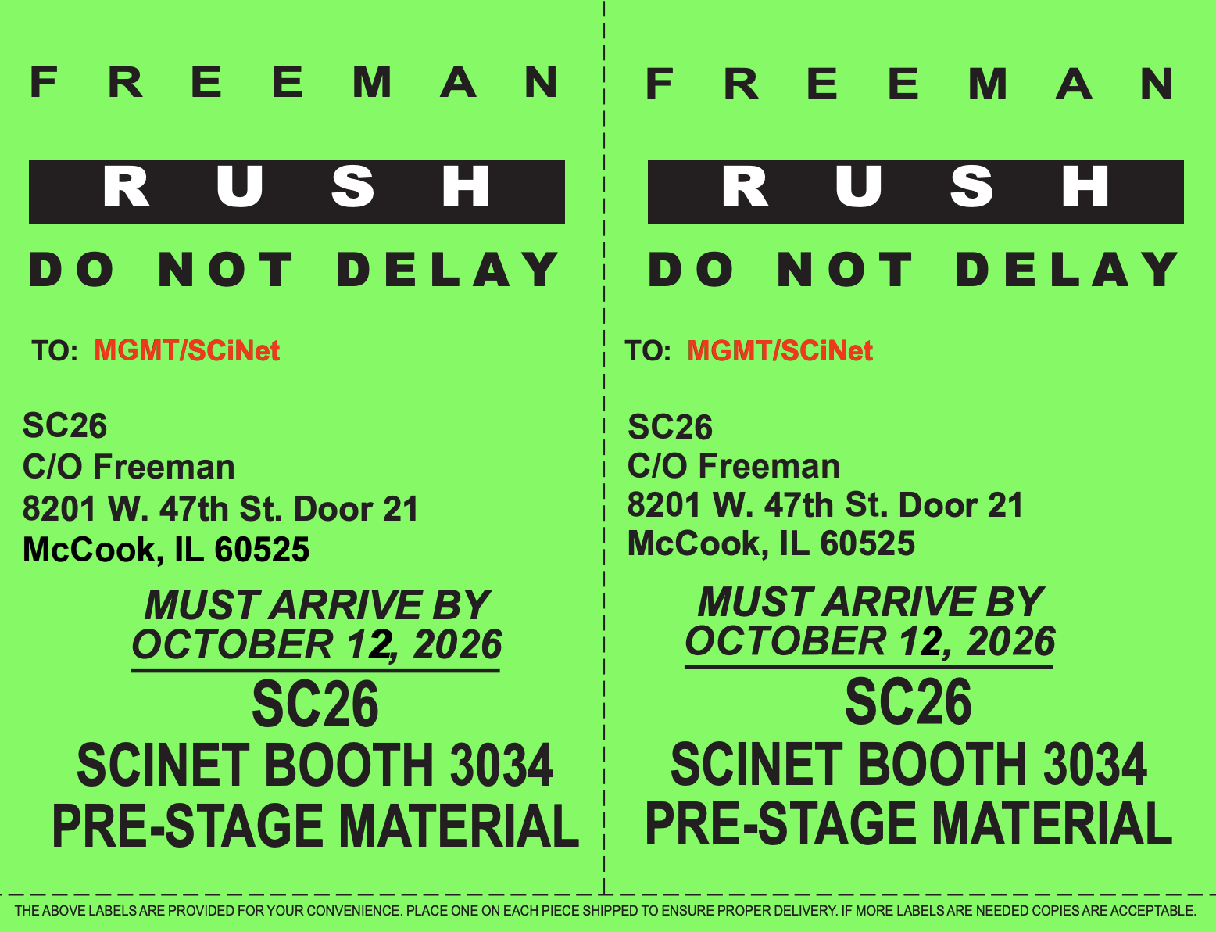
Shipping Label

Slide 26
Outbound Shipping
Preference is to ship via Freeman
  Shipping via other carries require you to hand carry the equipment out of convention center or arrange pickup
  Current plan of record is outbound shipping via Freeman will be covered by SCinet
CR/Logistics will apply shipping labels on all equipment boxes
Verify outbound equipment with the check-in inventory list
Hand carried equipment requires a signature which releases all responsibility to the signatory
  Hand carry items will be dispatched as they are checked in and cannot be guaranteed to be ready by any specific time during teardown. CR/Logistics will make a “best effort” to get hand carry items released early if informed ahead of time
More details from Logistics closer to the conference
Outbound shipping information due before show starts (Logistics/CR will send email for an outbound shipping form)

Slide 27
Key Dates
Contributor Intent to Participate Due Friday, May 29
Initial Bill of Materials Friday, June 19
Liability Waivers due Friday, June 19
Updated Bill of Materials Due Friday, August 7
Final Bill of Materials Due (used for insurance) Friday, September 4
Outbound Shipper Paperwork Submitted Friday, September 4
Loaned Equipment Received Wednesday, October 14
“Extra Mile” Contribution Declaration Friday, August 28
Contributor Logos submitted Friday, July 31
SCinet Panel Artwork submitted Friday, September 4
Request complimentary exhibitor passes Friday, October 30
Network connection transfer request submitted Friday, September 25
Co-branded Apparel Shipment Received Wednesday, October 14
Confirmation of Initial Benefit Level Achieved Friday, August 14
Apparel Sizes and Quantities Released Friday, August 14
Final Valuation Change Deadline Friday, September 4
Confirmation of Final Benefit Level Achieved Friday, November 13
Freeman Outbound Shipping Date Saturday, November 21

Slide 28
Resources
CR Portal:
  https://scinet.supercomputing.org/contributor-relations
  Forms, shipping labels, these slides, this presentation’s recording, CR Guidebook, table of important dates
Contributor Relations Email:
  contributor-relations@scinet.supercomputing.org

Slide 29
Questions?
Questions?

